Slide 1

Automatic Water Pump Controller
Group 2
Omar SHIRWA
İsmail AYDIN
Hamza HACIBAYRAMOĞLU
Muhammed İlyas TUMAN

Slide 2
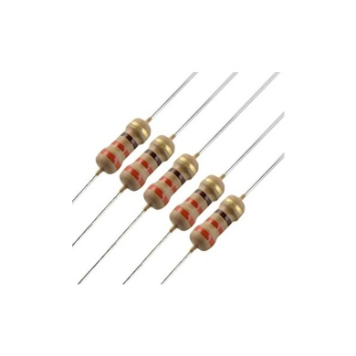
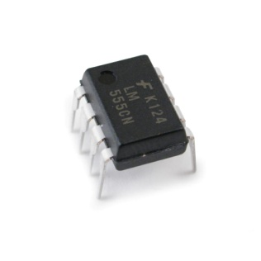
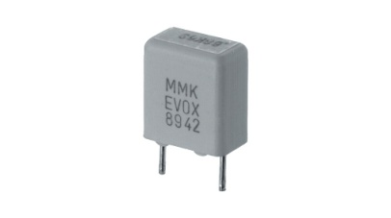
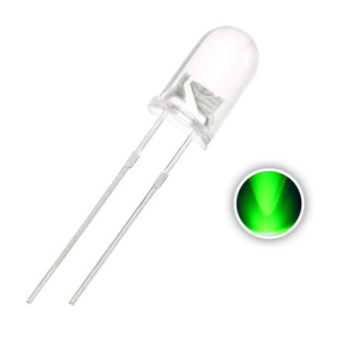
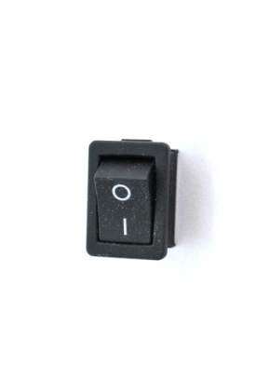
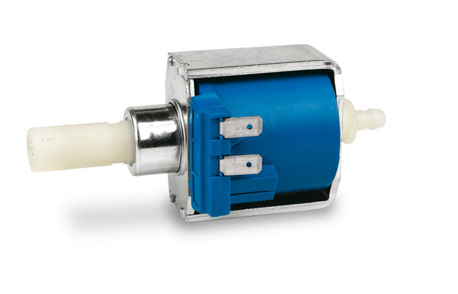
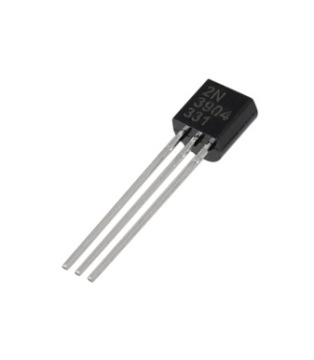
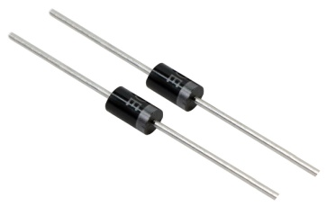
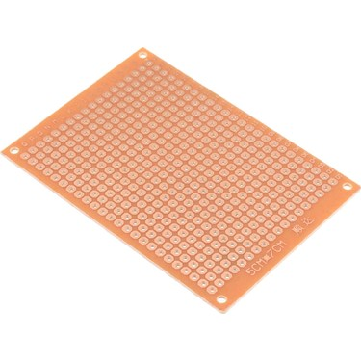
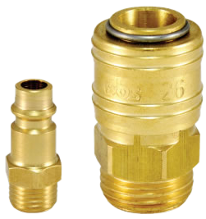
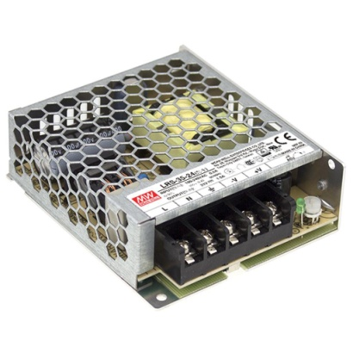
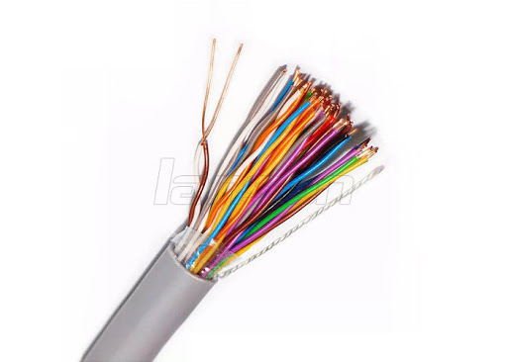
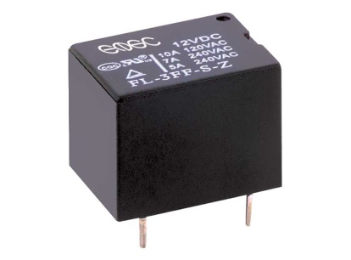
The Components IC NE555 Timer Transistors BC547 Resistors (R1 - R2) 1M Ω Resistors(R3 - R4) 1k Ω Resistor (R5) 180k Ω Resistors (R6 - R7) 22k Ω 12 V Relay 1N 4007 Diode A LED Ceramic Capacitor 100nF A LRS Ceme Solenoid Pump 3 Pneumatic jack Hole Board A switch Cables (telephone cables)

Slide 3
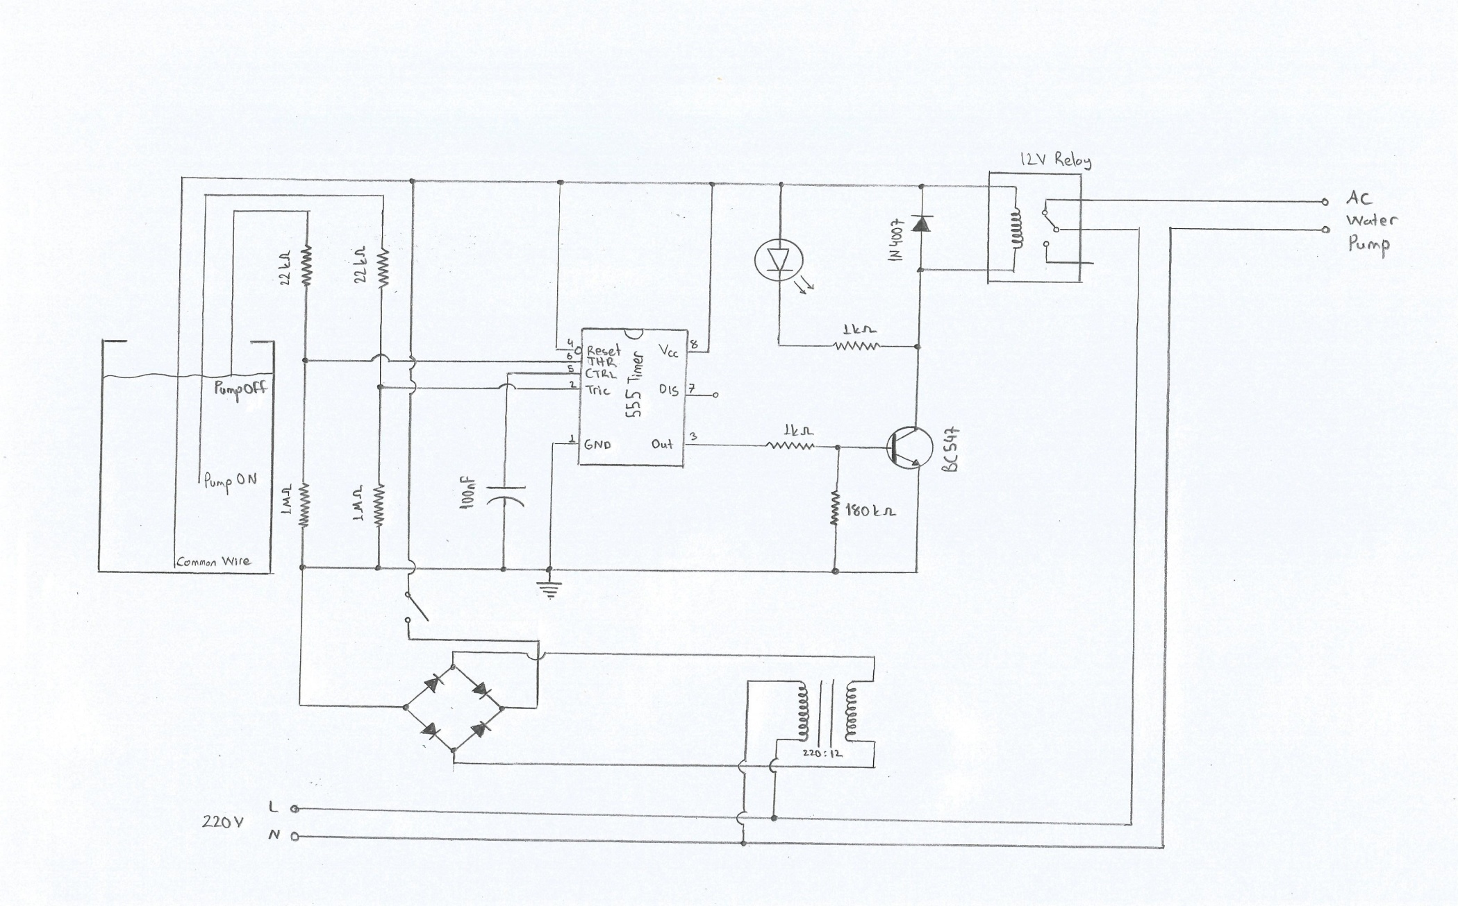
Circuit Diagram

Slide 4
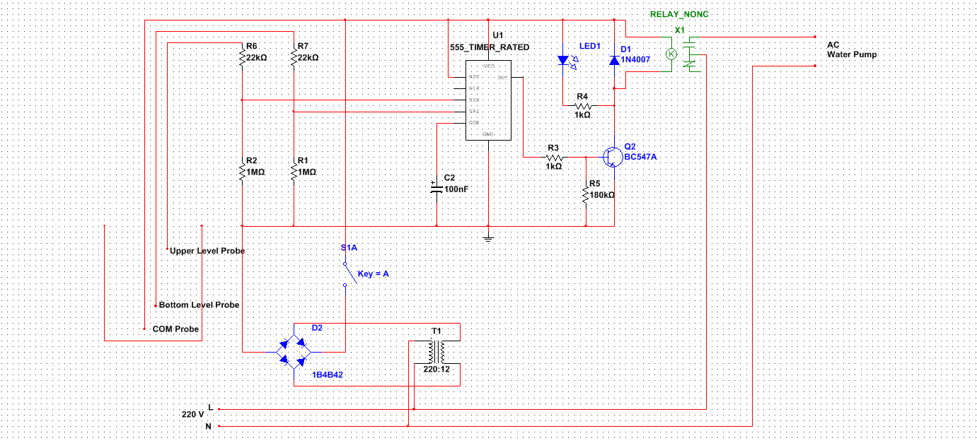
Multisim Circuit

Slide 5
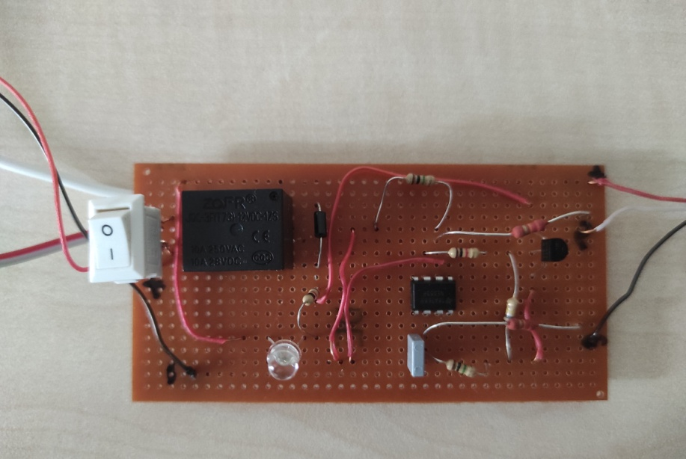
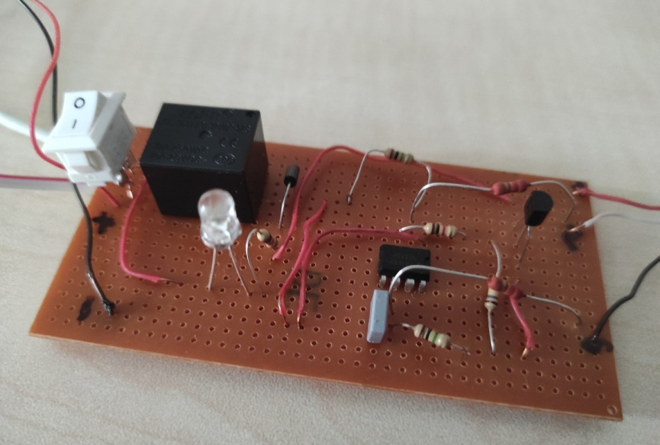
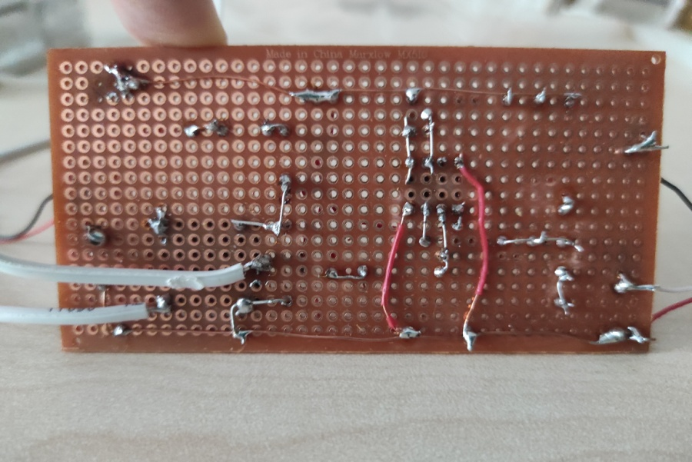
The build of our circuit

Slide 6
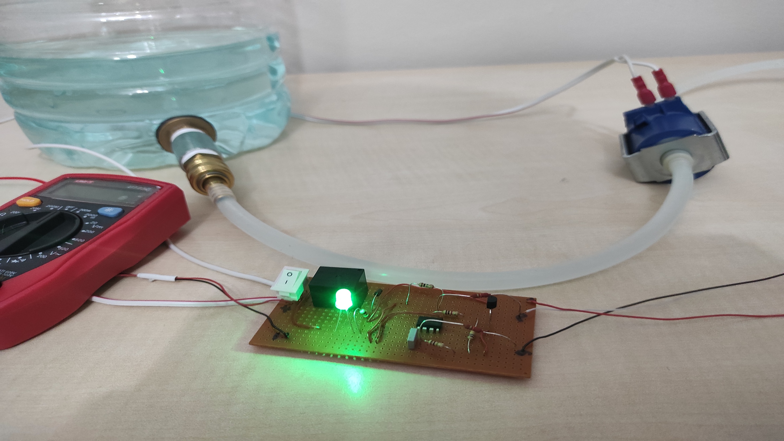

Slide 7
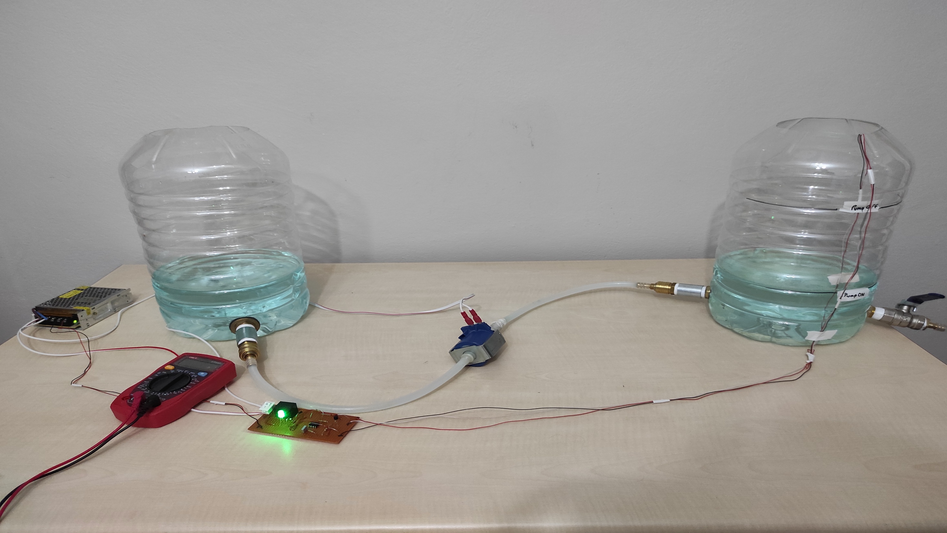

Slide 8


